Slide 1
Variable and Data Types in Java
Variable is a name of memory location.
There are three types of variables: Local, Instance and Static.
There are two types of data types in Java, Primitive and Non-primitive.

Slide 2
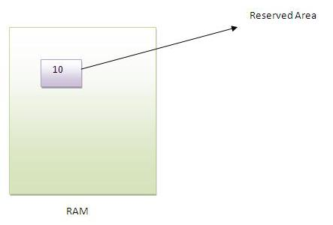
Variable :
Variable is name of reserved area allocated in memory.
int data=50;//
Here data is variable

Slide 3
There Are Three Types Of Variables In Java
Local
Variable
Instance
Variable
Static
Variable

Slide 4
Local Variable :
A variable that is declared inside the method is called local variable.
Instance Variable :
A variable that is declared inside the class but outside the method is called instance variable. It is not declared as static.
Static Variable :
A variable that is declared as static is called static variable. It cannot be local.
We will have detailed learning of these variables in next chapters.

Slide 5
Example to understand the types of variables
class A{
int data=50;//instance variable
static int m=100;//static variable
void method(){
int n=90;//local variable
}
}//end of class

Slide 6
Data Types in Java
In Java, There are Two Types of Data Types
Primitive
Data Types
Non-Primitive Data Types

Slide 7
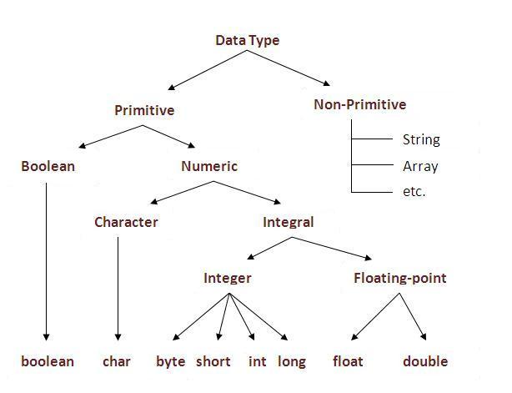

Slide 8
Data Type | Default Value | Default Size
boolean false 1 bit
char '\u0000' 2 byte
byte 0 1 byte
short 0 2 byte
int 0 4 byte
long 0L 8 byte
float 0.0f 4 byte
double 0.0d 8 byte

